Slide 1
Early Fraud Detection – Email Monitoring Daily Report
1/24/2018
Email Feed:
From | To | Time | Title | Status
Marlene.olivares@gmail.com | Sebastian.pineda@yahoo.es | 08:03 am 1/24/2018 | December Results | Suspicious
Enrique.Miranda@gmail.com | Ricardo.islas@gmail.com | 10:42 am 1/24/2018 | Family photos | Suspicious
Aquiles.pinto@gmail.com | Armando.paredes@gmail.com | 15:27 pm 1/24/2018 | Got tickets for the game | Suspicious
Follow ups:
From | To | Time | Title | Type
Carlos.tapia@gmail.com | Daniela.Vargas@aol.com | 09:36 am 1/24/2018 | RE: About what you saw on the books | Reply
Miguel.gonzalez@gmail.com | Rodrigo.vega@gmail.com, Ramiro.Lopez@hotmail.com, John.smith@gmail.com | 16:12 pm 1/24/2018 | FW: Let’s move this forward | Forward

Slide 2
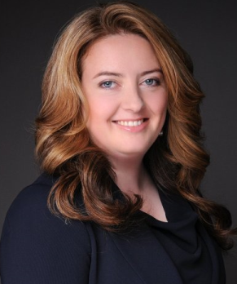
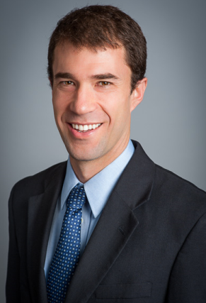
Email View
Suspicious Index
87%
Title: December Results
From:
To:
Body:
Name: Marlene Olivares
Role: Accountant
DOJ: 03-05-2014
Click for Profile
Hi Sebastian:
I reviewed your sales report from previous month and I noticed some special fees that don’t seem right. I looked back at previous report and saw a pattern that I think we should talk about. I’d be happy to keep this between us but I’ll need some convincing.
Come by my office to take this offline.
Thanks!
Name: Sebastian Pineda
Role: Sales Executive
DOJ: 09-17-2015
Click for Profile
Actions
Unfollow
Follow
Escalate

Slide 3
Day goes by, a new report is generated…

Slide 4
Early Fraud Detection – Email Monitoring Daily Report
1/25/2018
Email Feed:
From | To | Time | Title | Status
Marcelo.urrutia@gmail.com | adolfo.munoz@hotmail.com | 09:45 am 1/25/2018 | Are you sure about this? | Suspicious
Carlos.fernandez@gmail.com | Loreto.arancibia@gmail.com | 11:58 am 1/25/2018 | Looks good to me | Suspicious
Follow ups:
From | To | Time | Title | Type
Sebastian.pineda@yahoo.es | Marlene.olivares@gmail.com | 09:36 am 1/25/2018 | RE: December Results | Reply
Sebastian.pineda@yahoo.es | Martina.poblete@gmail.com | 09:40 am 1/25/2018 | Marlene’s onto us | New Email

Slide 5

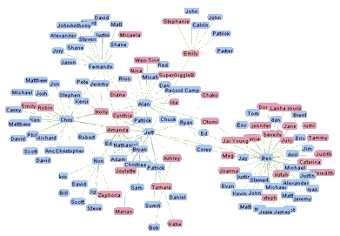
User Profile: Marlene Olivares
Name: Marlene Olivares
Role: Accountant
Manager: Miguel Hernandez
Department: Accounting
DOJ: 03-05-2014
Total Emails since DOJ: 4,978
Suspicious Emails since DOJ: 4 (Click Here to view)
Most Connected User: Adrian Martínez (8% of Email Traffic)
Connectedness: 0.48 (+0.32% Above Average)
Betweeness: 0.61 (+12% Above Average)
Closeness: 0.24 (-14% Below Average)
Social Network Map:
Email Behavior:
Hourly Frequency
Back

Slide 6

Suspicious Emails: Marlene Olivares
From | To | Time | Title | Status
Marlene.olivares@gmail.com | Mirta.gomez@yahoo.es | 09:45 am 8/9/2014 | Will you look at this! | Unfollowed
Ignacio.Garcia@aol.com | Marlene.olivares@gmail.com | 15:16 am 12/15/2016 | Client meeting | Unfollowed
Miguel.hernandez@gmail.com | Marlene.olivares@gmail.com | 15:27 pm 1/24/2018 | Something’s off here… | Escalated
Marlene.olivares@gmail.com | Sebastian.pineda@yahoo.es | 08:03 am 1/24/2018 | December Results | Followed
Back

Slide 7
Email Follow-up View
Suspicious Index
92%
Title: RE: December Results
From:
Body:
Name: Sebastian Pineda
Role: Sales Executive
DOJ: 09-17-2015
Click for Profile
Hi Marlene:
Thank you for your comments, I’ll set up a meeting to further discuss this. I know this sounds fishy but I’m sure we can work it out.
Thanks!
------------------------------------------------------------------------
Hi Sebastian:
I reviewed your sales report from previous month and I noticed some special fees that don’t seem right. I looked back at previous report and saw a pattern that I think we should talk about. I’d be happy to keep this between us but I’ll need some convincing.
Come by my office to take this offline.
Thanks!
To:
Name: Marlene Olivares
Role: Accountant
DOJ: 03-05-2014
Click for Profile
Actions
Unfollow
Follow
Escalate

Slide 8
Escalate Activity
From: Early Fraud Detection Team
To: Compliance Manager
Hello,
We’ve detected the following suspicious email activity. Please evaluate if any further action is required.
Thank you.
Early Fraud Detection Team

